Slide 1

DSA & OOPS Project
Movie Ticket Booking System
Team Mates:
1. T.BALAPRASANNA KUMAR-> CB.SC.U4AIE24256
2. P.VARUN -> CB.SC.U4AIE24244
3. G.G.RISHI KANTH -> CB.SC.U4AIE24218
4. K.SAI GANESH -> CB.SC.U4AIE24226

Slide 2
Table of Contents:
Abstract
Introduction
Array Operations & Hash Tables
Searching & Sorting Algorithms
OOPS Concepts
Objectives
Methodology
Flowchart Diagram
OOPS Structure

Slide 3
ABSTRACT
The Movie Ticket Booking System is designed to optimize and simplify the process of booking movie tickets using data structures, algorithms, and OOP.
The core features include user registration, movie browsing, seat selection, ticket booking, payment processing, and booking history tracking.
This project showcases the practical application of data structures and OOP concepts in real-world scenarios. Its structured design makes it a potential prototype for commercial ticket booking platforms that require efficiency, scalability, and seamless user interaction.

Slide 4
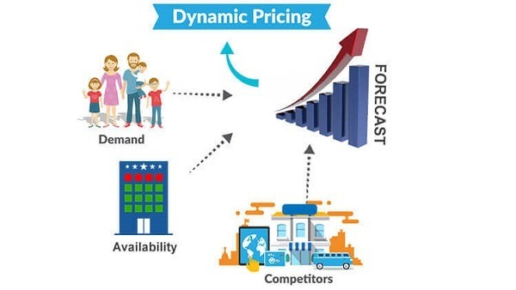
INTRODUCTION
This project aims to develop an efficient, user-friendly Movie Ticket Booking System using modern programming techniques and data structures.
It ensures:
- Fast & scalable booking with real- time seat availability
- Secure payments & concurrent user handling
- Advanced features like priority-based seat allocation, dynamic pricing, and optimized database management for high performance.

Slide 5
METHODOLOGY
DATA STRUCTURES
Data Structure | How It's Used in Your System | Real-World Application
Linked List | Manages ticket bookings (allocation & cancellation) | Airline & movie booking systems
Hash Tables | Stores user data, movies, and theatres for quick lookup | Fast database access in ticketing platforms
Arrays | Stores movies, theatres, and showtimes in an ordered manner | Product listing on e-commerce sites
3

Slide 6
ALGORITHMS
Algorithm | How It's Used in the System | Real-World Application
Searching (Linear Search) | Quickly finds movies, shows, and seat availability | Search engines, Amazon product search
Sorting (Merge Sort, Quick Sort) | Sorts movies by rating, popularity, and timing | Netflix recommendations, YouTube trending
4

Slide 7
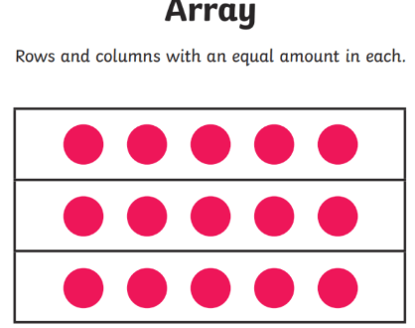
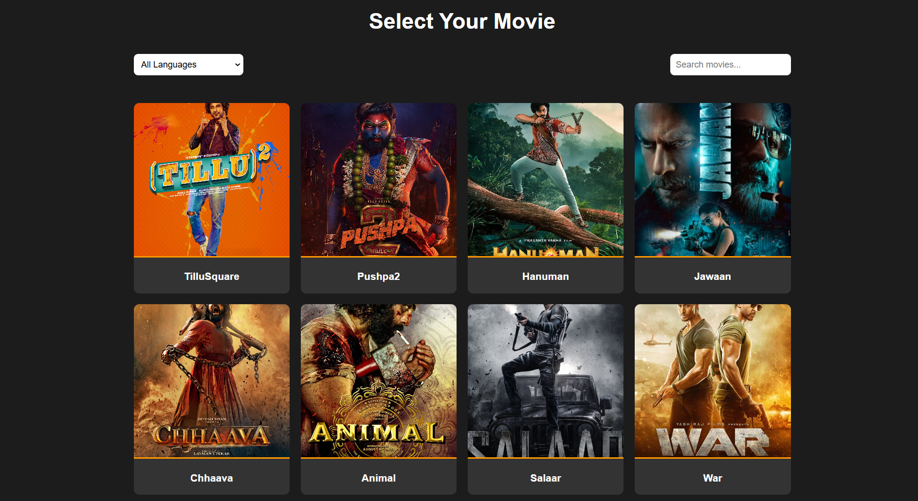
Array
It is best for searching & sorting
It grows Dynamically
Accessing Elements(Indexing)
Best case :- O(1)
Worst case :- O(1)
Search Operation (Linear Search)
1.Best Case:- O(1)
2.Worst Case:- O(n)

Slide 8
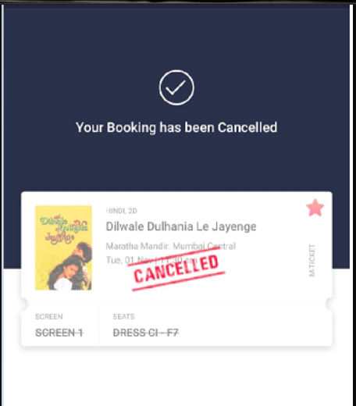
Linked List
It is best used for managing the seats (ticket booking/cancelation)
Time complexity for deletion
Best Case: O(1) (if deleting the head node)
Worst Case: O(n) (if searching for the node before deletion)

Slide 9
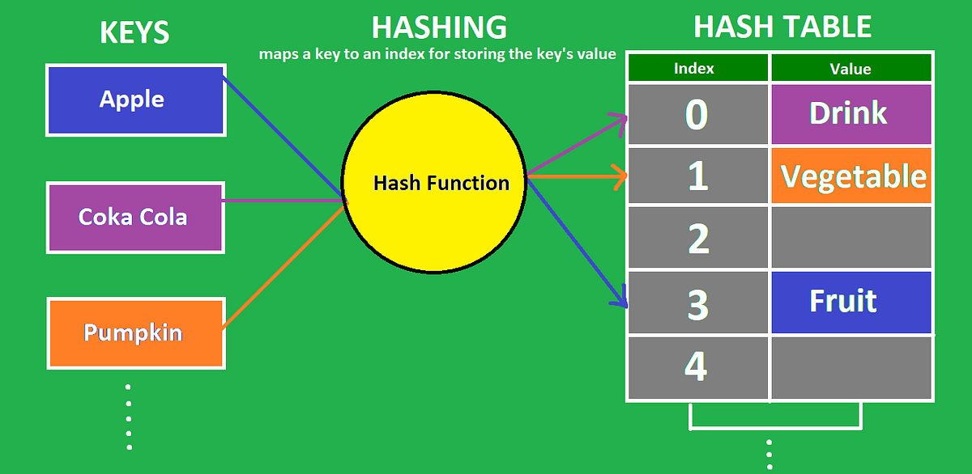
Hash Table
Used for storing user details and Movie show times .
Best Case :- O(1)
Worst case :- O(n)
Example:-
Searching a Booking by user Mobile number
Key value pair
Key | Value
Name | Rishi
Age | 18
Phone number | 93974291018

Slide 10
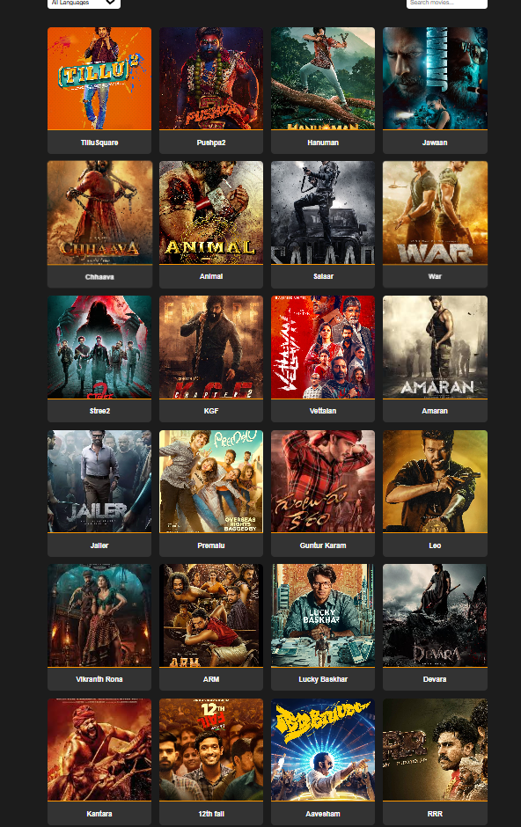
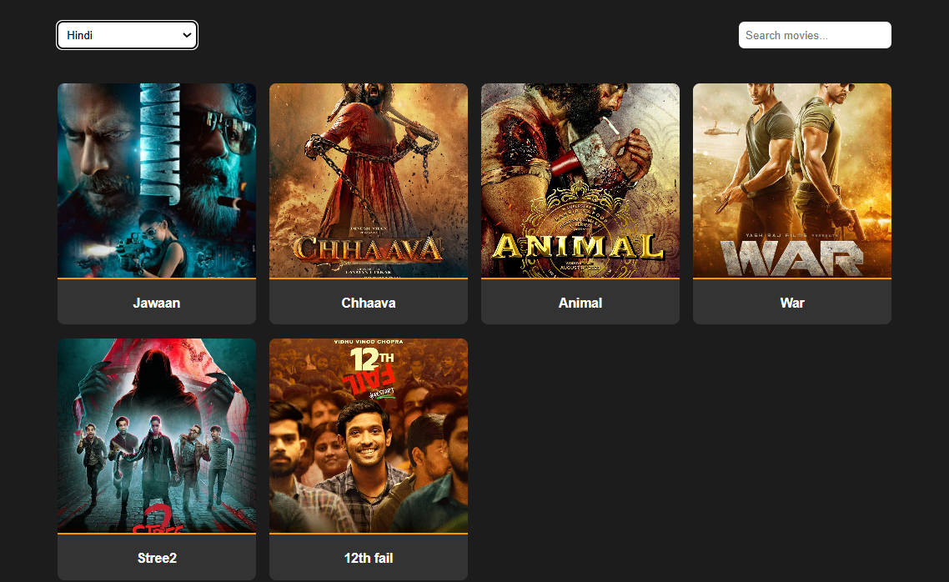
Sorting
Before Sorting
It is used for sorting movies based on language etc.
Bubble Sort is best for small datasets
Best Case :- O(n) if (already sorted)
Worst Case:- O(n^2) (reverse sorted)
Merge Sort for large datasets
Best Case :- O(nlogn)
Worst Case :- O(nlogn)
After Sorting

Slide 11
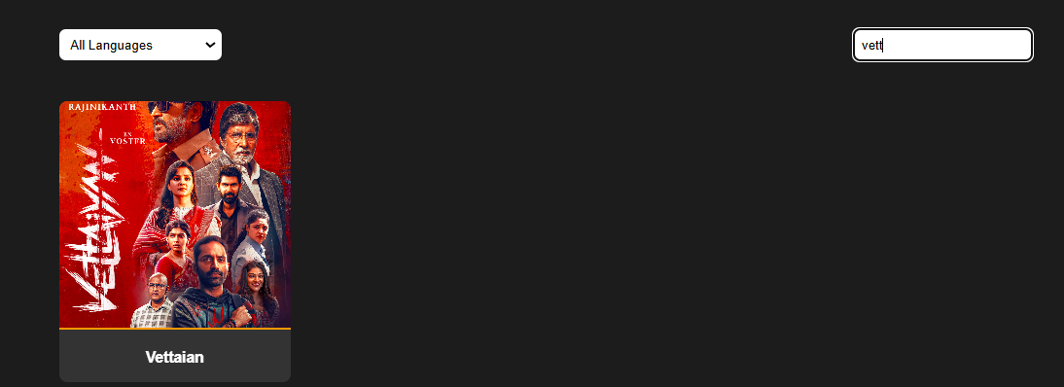
Searching
It is used for searching a particular Movie
Linear Search is used for small data
Best Case:-O(1) (First element match)
Worst Case:-O(n) (Last element match or not found)
After linear
search

Slide 12
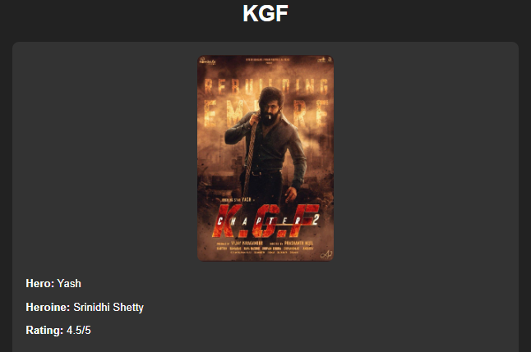
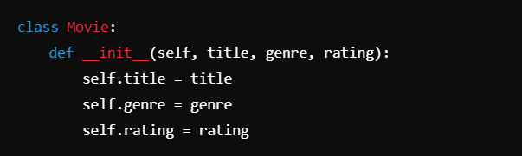
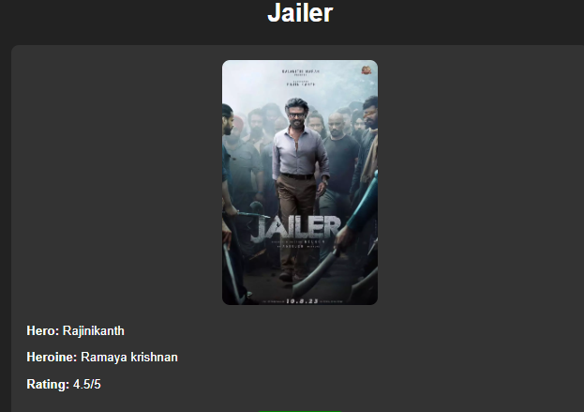
Class & Objects
Class
Object
Class
Objects
Class
Object

Slide 13
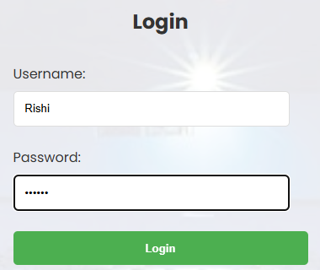
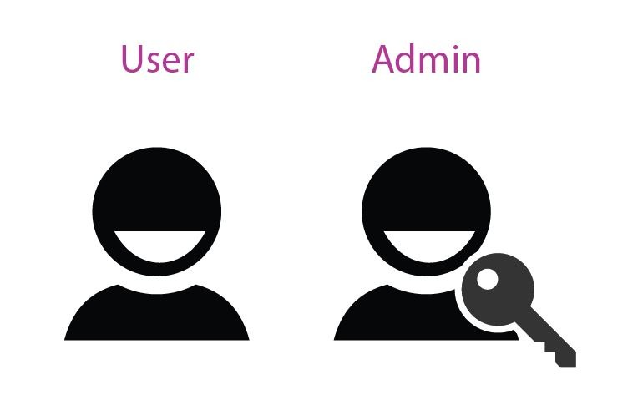
Encapsulation
User authentication (username & password stored securely).
Movie & Seat Management
Prevents direct access to the seat list
Ensures validation before modification
Improves security and maintainability
Polymorphism (Function Overriding)
Different types of users (Admin, Customer)

Slide 14
OBJECTIVES
Optimize Ticket Management: Implement efficient data structures (like linked lists and hash maps) to handle ticket bookings, cancellations, and movie details in real-time.
Improve Scalability and Performance: Use algorithms that support fast searching, sorting, and dynamic seat allocation, ensuring the system can scale to handle concurrent users without performance issues.
Secure Payment Processing: Integrate a robust payment gateway that ensures secure and reliable transactions while maintaining user privacy.
6

Slide 15
Start
Flowchart Diagram:
User Login
Browse Movies/ Shows
Select Seats & Showtime
Check Seat Availability
Proceed to Payment
Show Error Message
Confirm Booking & Send Ticket
Fig.1
End
9

Slide 16

OOPS STRUCTURE :
User
-user ID
-Name
- email
- register()
- login()
Booking
- booking ID
-user ID
- Movie ID
Seat No
confirm Booking()
-cancel Booking()
(Encapsulation: Private user data)
Movie
- movie ID
-Title
- duration
- Get Details()
Show
- show ID
- movie ID
- time
- Allocate Seats()
(Polymorphism: Different seat allocation strategies)
Aggregation
(Aggregation: Movie has multiple shows)
(Polymorphism: Different seat allocation methods)
11

Slide 17
Thank You

